Slide 1

Azure management tools

Slide 2
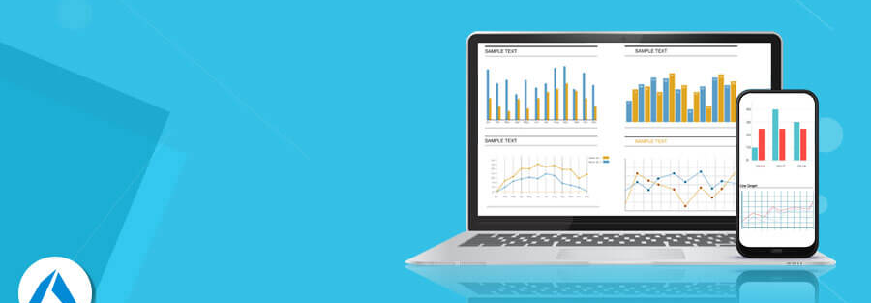
Azure Portal
A web-based interface for managing Azure resources and services, providing a graphical user experience for creating, configuring, and monitoring resources.

Slide 3
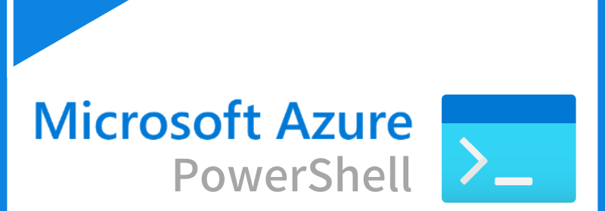
Azure PowerShell
A set of cmdlets for managing Azure resources directly from the PowerShell command line, allowing for automation and scripting of complex tasks.

Slide 4
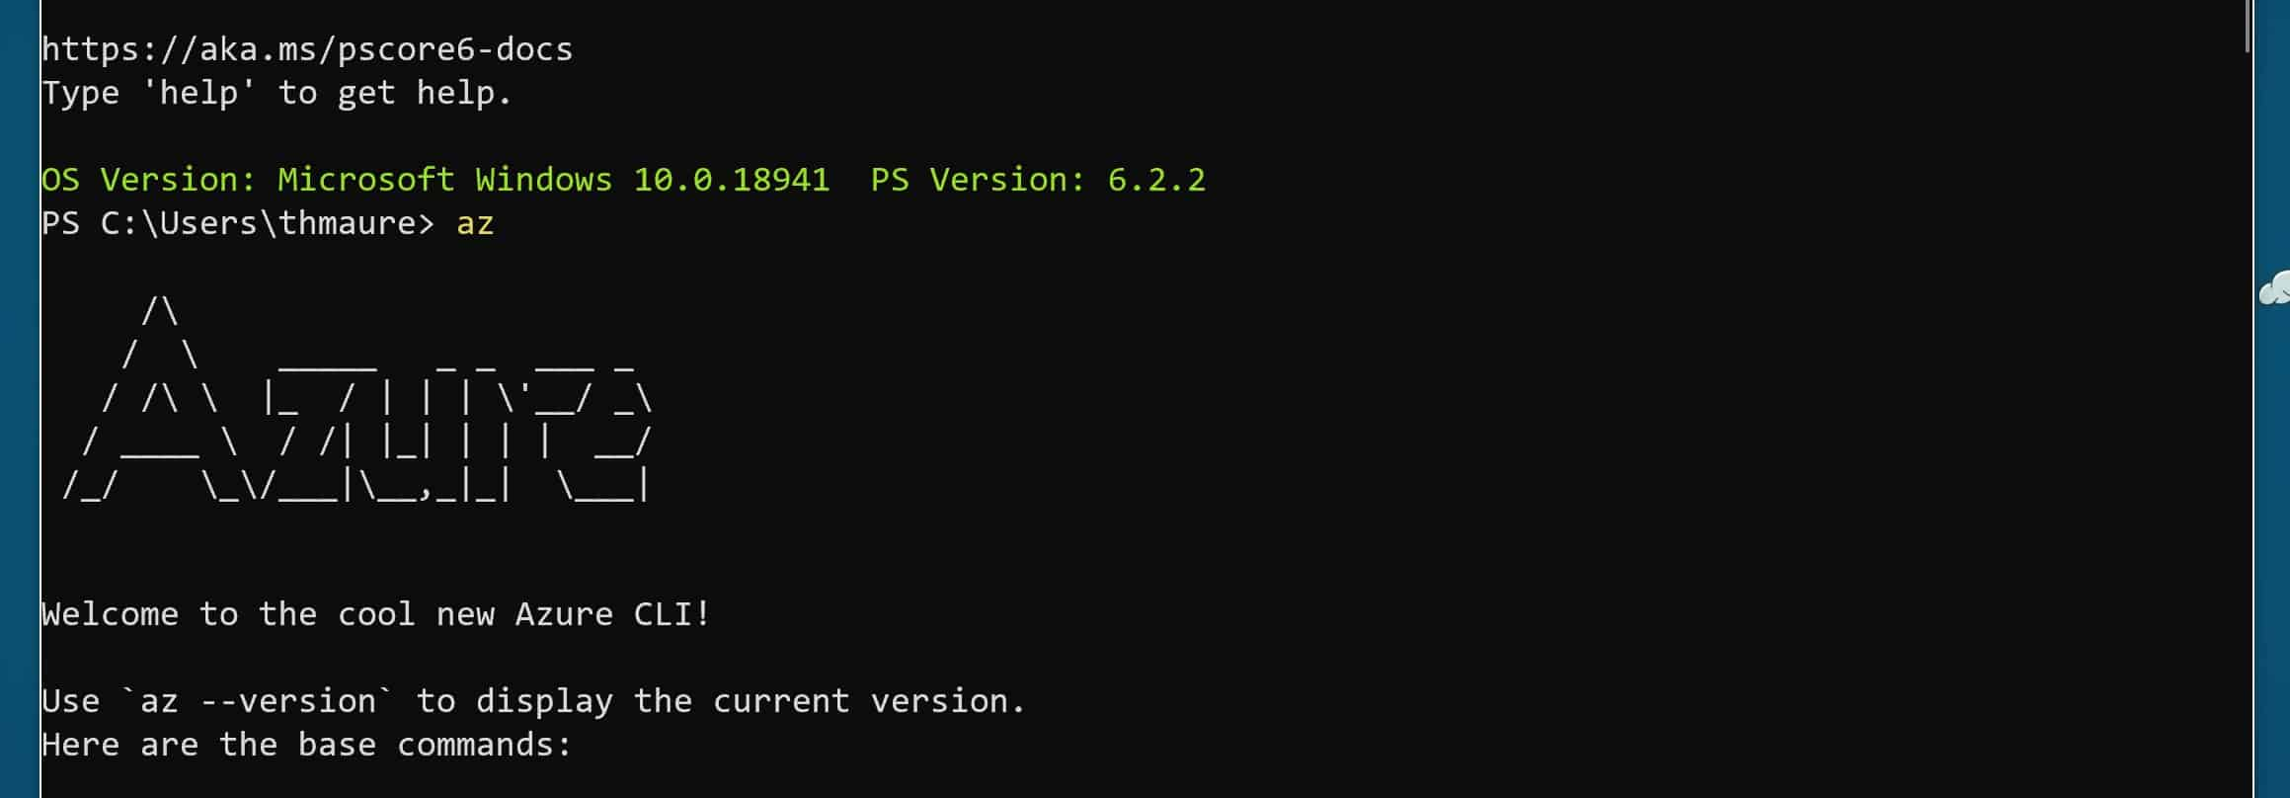
Azure CLI (Command-Line Interface)
A cross-platform command-line tool for managing Azure resources, offering a simple syntax for creating and managing services.

